Slide 1

DDS Analytics
Employee Attrition Analysis
Rinku Lichti
Dec 5th, 2020

Slide 2
Goals
Study Attrition and Compensation
Explore trends
Identify factors that lead to Attrition
Predict employee Attrition and monthly salary
Make recommendations

Slide 3
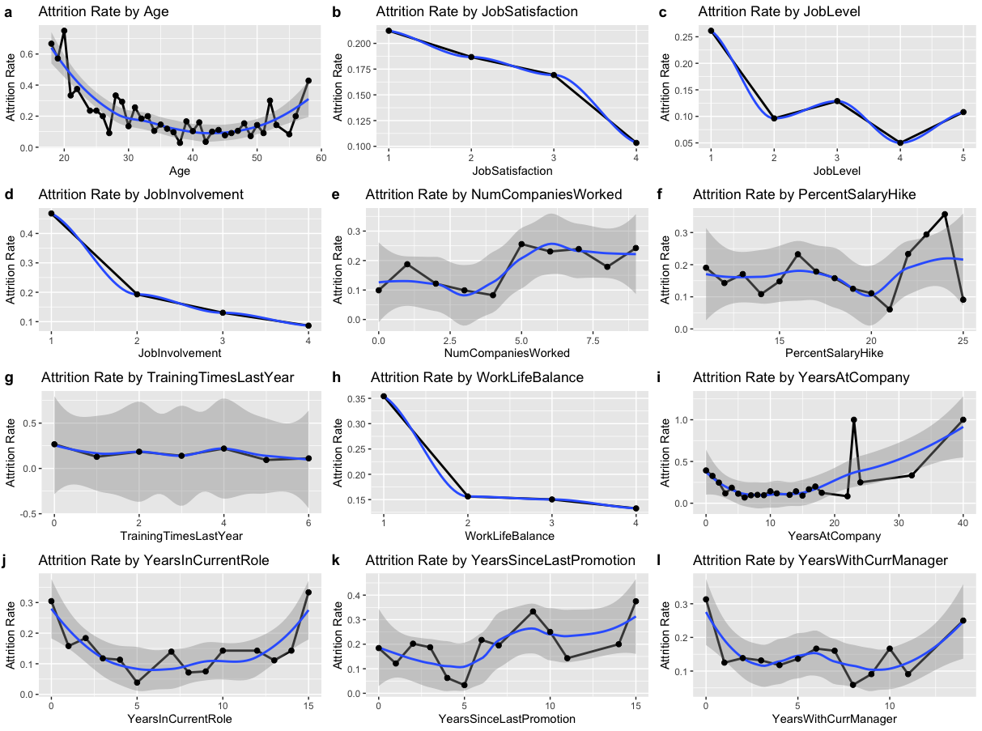
Notes:
Here I’m looking at Attrition Rate as it is influenced by different variables. Flat lines suggest no influence. Anything that isn’t flat suggests a relationship.
Clearly Age, Job Satisfaction, Job Level, Job Involvement, WorkLifeBalance
Years At Company may have a few data points at high number of years distorting an otherwise flat line.

Slide 4
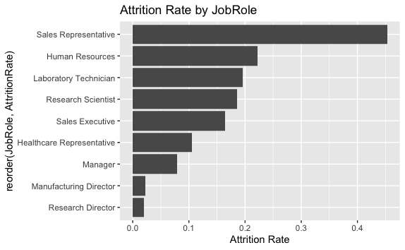
Job Role and Attrition Rate
Notes:
Sales Representative have the highest attrition rate by a wide margin. Whereas, Research Director & Manufacturing Director have the lowest

Slide 5
Top Factors Contributing to Monthly Income
JobLevel | 37.49832
JobRole | 28.58650
TotalWorkingYears | 17.97232

Slide 6
Top Factors Contributing to Attrition
OverTime | 12.533080
JobRole | 9.021616
JobInvolvement | 7.215958
MonthlyIncome | 7.214574
StockOptionLevel | 6.929491
JobLevel | 6.144694
Notes:
Top factors according to random forest importance

Slide 7
Correlation of top factors for MonthlyIncome
Notes:
Monthly income is 95% correlated with Job Level and 78% correlated with Total WorkingYears.

Slide 8
Models: Monthly Income

Slide 9
Monthly Income Linear Regression Results
RMSE: 1165.628
Notes:
Normality, Linearity, and other Assumptions appear to be met.
There are some outliers, but RMSE is already less than the 3,000 required in this study, so this model is sufficient.

Slide 10
Monthly Income Random Forest Results
Notes:
JobLevel is the most important predictor by far in our Random Forest; appear most often as the top node in the trees grown.
The rest of the model is driven by JobRole, seniority, and related factors

Slide 11
Monthly Income Random Forest Results
Notes:
The most frequently occurring interaction in our forest is between JobLevel and itself, but JobRoleResearchDirector and TotalWorkingYears.

Slide 12
Comparing Monthly Income Models
model | RMSE
Linear Regression | 1165.628
Random Forest | 1087.495
Notes:
Random Forest has the lowest RMSE and is our winner for predicting Monthly Income accurately.

Slide 13
Models: Attrition

Slide 14
Attrition KNN Results
Notes:
I chose to optimize for Kappa because it is better suited for imbalanced classification problems, and our Attrition data is imbalanced; with fewer “yes” values.
The best Kappa on the training set was achieved with k = 4

Slide 15
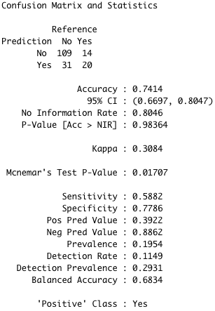
Attrition KNN Results
Notes:
On the test data, and after using an ROC curve to find a balanced cut-off probability, KNN achieved 74% Accuracy, a Kappa of 31 implying fair agreement, a Sensitivity of 58%, and Specificity of 77%
This KNN model is not meeting our needs for this case study, due to Sensitivity being below 60%. Let’s see how Random Forest does.

Slide 16
Attrition Random Forest Results
Notes:
For Random Forest, I tuned several splitting rules plus the mtry parameter, which tells Random Forest how many randomly chosen variables to consider during each split.
The gini split rule won, with an mtry of 9.

Slide 17
Attrition Random Forest Results
Notes:
The biggest individual drivers in our random forest are OverTimeYes, TotalWorkingYears, MonthlyIncome, and Age; all appearing most frequently high up in their respective trees.

Slide 18
Attrition Random Forest Results
Notes:
Interaction between OvertimeYes and HourlyRate is the most frequently occurring interaction, but OverTimeYes and TotalWorkingYears, when they interact, generally do so higher up in their respective trees, and so exert more influence.

Slide 19
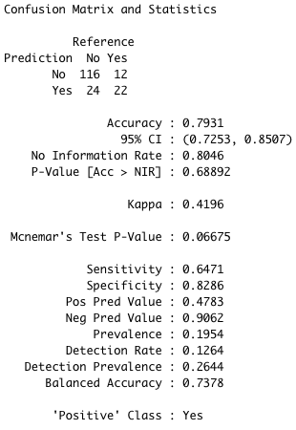
Attrition Random Forest Results
Notes:
On the test data, and after using an ROC curve to find a balanced cut-off probability, RandomForest achieved 79% Accuracy, a Kappa of 42 implying moderate agreement, a Sensitivity of 65%, and Specificity of 83%
This Random Forest model definitely meets our needs for this case study, with both Sensitivity and Specificity comfortably abogve 60%.

Slide 20
Attrition Model Comparison
Model | Accuracy | Kappa | Sensitivity | Specificity
KNN | 0.7413793 | 0.3084261 | 0.5882353 | 0.7785714
Random Forest | 0.7758621 | 0.4222714 | 0.7352941 | 0.7857143

Slide 21
Conclusions
Sales Representatives have the highest Attrition
Directors have the lowest Attrition
With some refinement, it is possible to use modeling to predict which employees are more likely to leave, then focus retention efforts on those employees
Overtime, Compensation, Job Role, and tenure at the company are strong drivers of attrition
Work Life Balance and Job Involvement may be easy levers to reduce Attrition

